Slide 1
PeerWise Cycle 1
Introduction to the Semester’s PeerWise Assignment Cycles
Details of Cycle 1

Slide 2
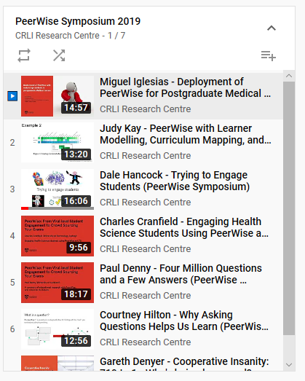
What is PeerWise?
Website where students create MCQs for other students
To do, and to comment on
Viral Engagement
Thousands of practice questions
Forces early interaction with material
Leverages benefits of Peer Teaching
Postgrad Med
Our work!
UTS Biochem
PW Creator
Neuro-cognative
If interested, just search for “PeerWise Symposium 2019” on YouTube
https://www.youtube.com/watch?v=d_SjULmPBpg&list=PL8ZUDrQBiaj6uTzIe6ql6HPm1vLERp54P

Slide 3
The Benefits of PeerWise are Sensational
>100 Research Studies show strong effect at all levels
Our research shows
Especially beneficial for borderline, ‘at-risk’ students
Average mark uplift for engagers >5 REAL marks
Recent analysis (unpublished) shows large effect on Short Answer Question (SAQ) marks
Ends up being a lot of work for us, but it is worth it

Slide 4
Overview of Semester PeerWise Activities
Cycle 1: 1 mark
Engage with Peerwise.
Recognize good/bad MCQs. Practice articulating opinion
Cycle 2: 1 mark
Practice question design. Gathering intel on misconceptions and insights.
Cycle 3: 1 mark
Develop skill of giving, and responding to, feedback about questions
Cycle 4: 3.5 marks
Author an MCQ on Molecular Biology. Contribute to peer MCQ development.
Cycle 5: 3.5 marks
Author an MCQ on Metabolism. Contribute to peer MCQ development.

Slide 5
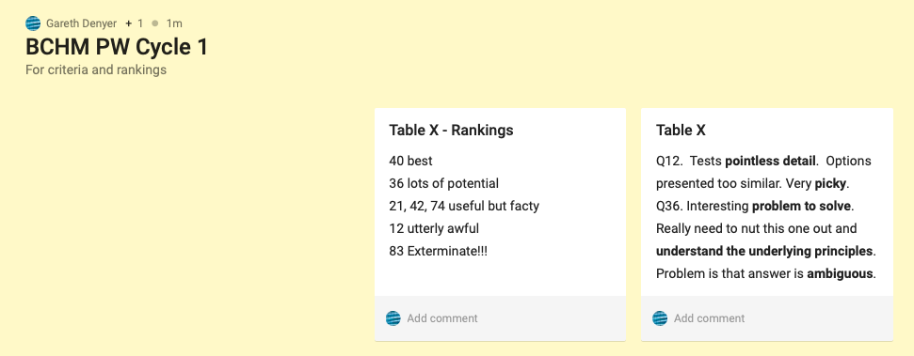
Activity #1: Discuss some MCQs
Let’s Try Padlet!
Discuss the merits of the MCQs provided
What criteria would you use to rate their quality?
Accuracy?
Alignment with the syllabus?
Effect on your learning?
Your confidence? Insight? Enlightenment?
Level of detail?
Too hard or too easy?
Requirement for reasoning vs recall?
For MEDS Thursday Week 4*
https://sydney.padlet.org/gareth_denyer1/y90e0a4p6ec1
Just double click on the screen to make a note
Tables 1-7 – start at Q (your table number)
Tables 8-14 – start at Q (your table – 7)
*For previous URLs see Notes section below
Notes:
Monday Week 3 – https://sydney.padlet.org/gareth_denyer1/43kmqt9tnef0
Tuesday Week 3 - https://sydney.padlet.org/gareth_denyer1/d5u68uhkus37
Wednesday Week 3 - https://sydney.padlet.org/gareth_denyer1/eosv1rtbeb2n
Thursday Week 3 - https://sydney.padlet.org/gareth_denyer1/jmji91x91qsv
Monday Week 4 - https://sydney.padlet.org/gareth_denyer1/n0e0j1cgeh3x
Tuesday Week 4 – https://sydney.padlet.org/gareth_denyer1/1svn1grnq7uz
Wednesday Week 4 – https://sydney.padlet.org/gareth_denyer1/v75ez9on4kqb
Thursday Week 4 - https://sydney.padlet.org/gareth_denyer1/y90e0a4p6ec1

Slide 6
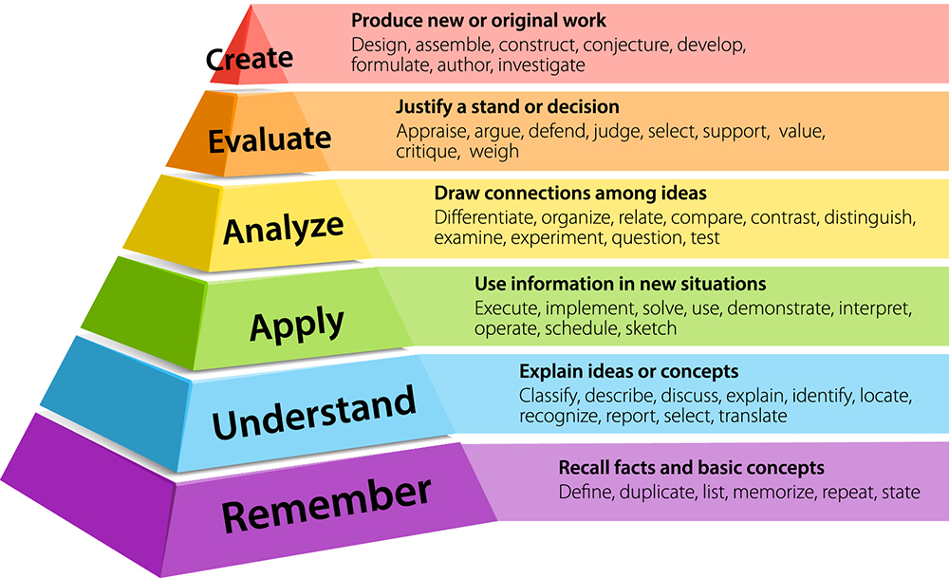
Blooms Taxonomy

Slide 7
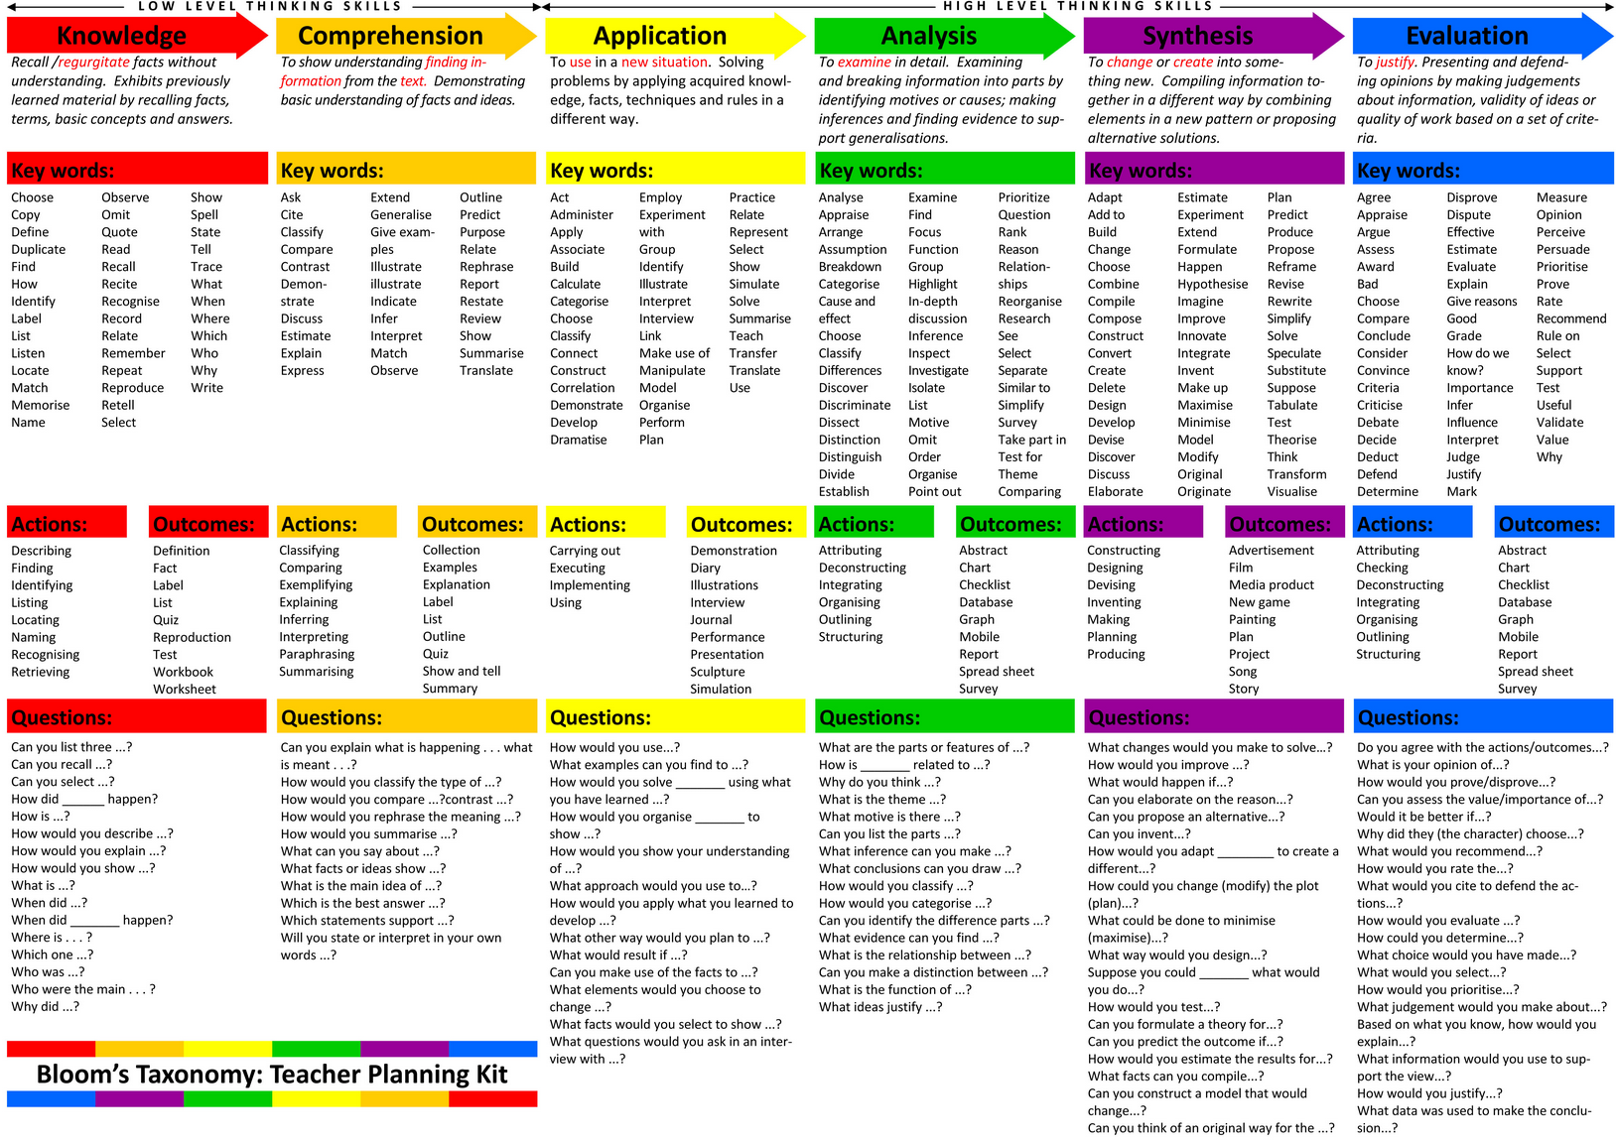
My recommendations in Cycle 2
kb.ecampus.uconn.edu

Slide 8
Articulating Opinion on MCQs
Build a set criteria that reflect some combination of:
Your values
What you think we want
Build a set of words that encapsulate those
This will make it very easy for you to give well articulated feedback from your perspective
Ultimately, getting articulate feedback from a variety of viewpoints is best for the author

Slide 9
Driving the Culture
MCQ needs to be based on intel
Engage early
No point in a question or comment submitted just before the ‘deadline’
Contribute more than syrupy platitudes
Thoughtful, informed, constructive, critical, specific
MCQ needs to be tested
MCQ needs to be revised
NEED TO CONVINCE YOU I’M SERIOUS

Slide 10
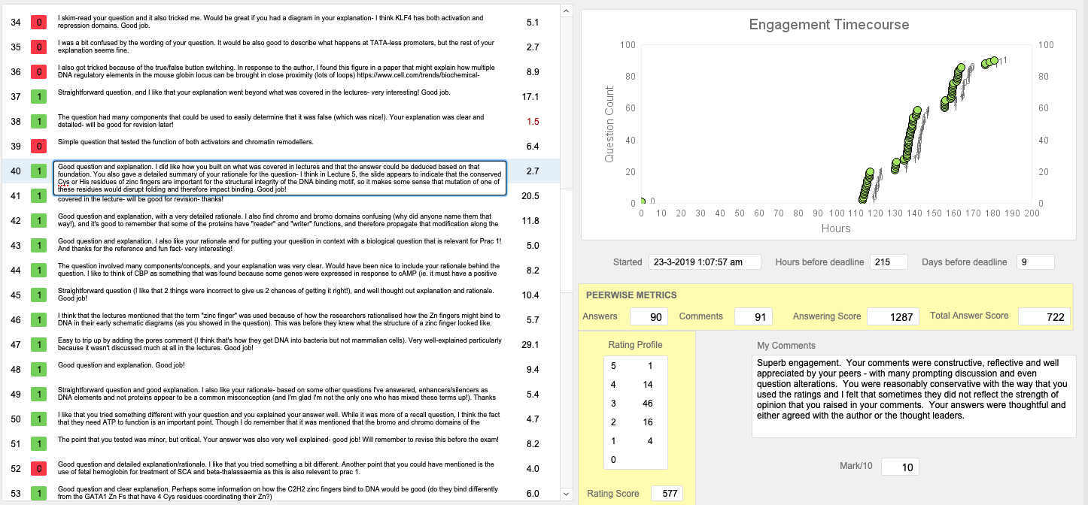
1
2
6
3
7
5
8
4
9
1 – answer right/wrong
2 – comment… less
3 – comment… expanded
4 – sometimes its all you can say
5 – time spent on question
6 – time course of answering
7 – when answering was started
8 – internally generated Peerwise metrics
9 – rating profile

Slide 11
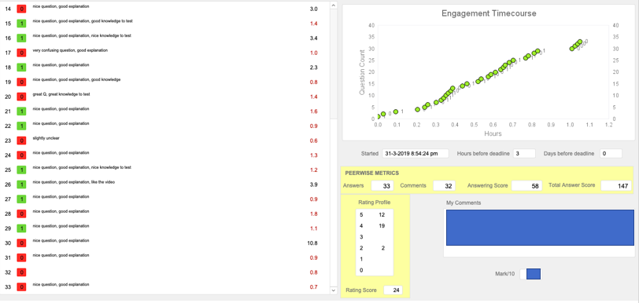
What do you note about this profile of engagement?

Slide 12
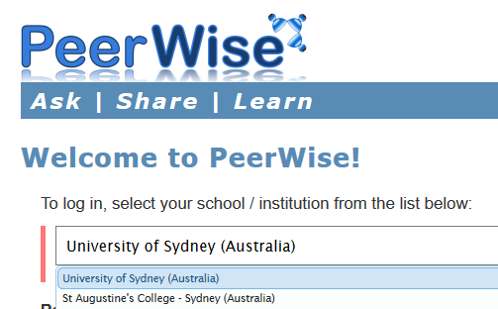
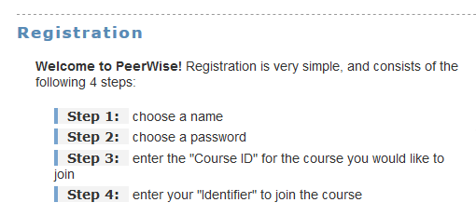
ACTIVITY #2: Comment in PeerWise
Create your PeerWise Account
https://peerwise.cs.auckland.ac.nz
Choose “University of Sydney”
First-time registration is two step
Choose a name/password for PEERWISE
Anything silly/personal is fine. NOT Uni stuff
Join a specific ‘course’
Specific Course ID and unikey
For THIS activity it is 21028
Comment on at least one of the questions using your criteria

Slide 13
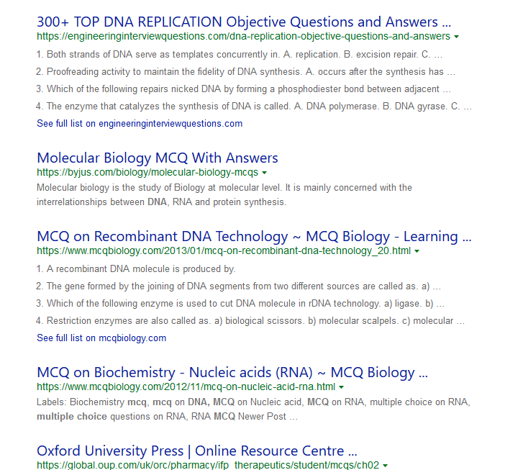
Populating Peerwise with MCQs
Each table allocated a topic from:
BCMB2 Mon/Tue – Lectures 1 and 2
BCMB2 Wed/Thu – Lectures 3 and 4
MEDS2 Mon/Tue – Lectures 5 and 6
MEDS2 Wed/Thu – Lectures 7 and 8
Finding a question
A simple web search for “DNA MCQ” brings up thousands…
Just tweak search a bit – eg, “DNA replication”
Discernment
Try to pick something good, but it doesn’t matter
ANYTHING vaguely on topic will be OK
Not being judged on Q choice
BUT the more effort you put in the better for ALL
For example

Slide 14
ACTIVITY #3: Add MCQ to PeerWise
Add your chosen question to PeerWise
This time to the specific course for your Day (as in table)
Tag it appropriately
Your table
Tags are under TOPICS in Peerwise
In explanation field
Cite the source (book, website)
Include source explanation (or your own)
By midnight tonight
 | Course IDs
Day | BCMB (Week 3) | MEDS (Week 4)
Mon | 20995 | 21070
Tue | 21037 | 21071
Wed | 21038 | 21072
Thurs | 21039 | 21073
Identifier will be Unikey

Slide 15
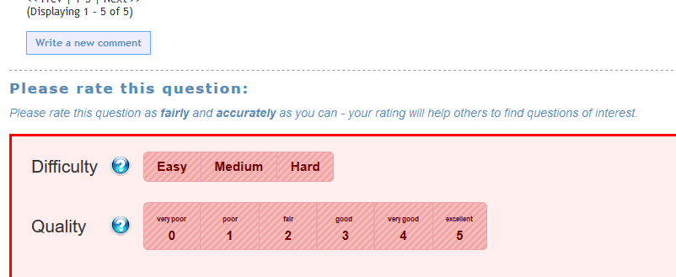
Homework: Classify Peer Questions
In the same course that you submitted your Q
Comment on the questions submitted by Tables +1 and +2 relative to you
1 does 2 and 3, 6 does 7 and 8
14 does 15 and 1, 15 does 1 and 2
Etc, etc
Comment on and classify 9-12 Qs
Judge freely!! Submitter does not own the Q… (may need to temper later!)
By midnight on this day next week
Trap for New Players:
Write comment, then save it before doing ratings
Use Quality scale to rate by Blooms
0 = Bottom level: Remember, Recall
6 = Top Level: Create, design

Slide 16
Summary Cycle 1 Assignment
Question on Peerwise by midnight tonight
Comments by midnight this day next week
1 mark total
Submit Q with stem, 4-5 options, source and source explanation (if any)
>9 articulate comments/classifications
NO ADVANTAGE IN LIMITING YOURSELF or BE TOO QUICK….
You have logged into TWO Peerwise courses
Course | Code | Purpose
BCMB2MEDS2 Cycle 1 All | 21028 | Commenting on my 7 example MCQs – not marked
Your Course and Day | Varies See Slide 14 | Submit your MCQ, comment on Peers’ MCQs - marked

